Slide 1
March Madness Win
Prediction
Using Efficiency and Matchup Features
Cooper Tammen
CIS 732A Term Project Presentation | Spring 2026

Slide 2
The Problem & Project Goal
March Madness: 68 teams, 67 games, single elimination
About 27% of games are upsets (lower seed wins)
Most bracket pickers rely on seed or name recognition
Millions of brackets filled out annually
Goal
Build and evaluate classification models that predict tournament outcomes, validated on held-out tournament years. Track 5: ML & Probabilistic Models Pillar: OA (Applied AI Systems)
1
Notes:
So, March Madness is a college basketball tournament with 68 teams, it is single elimination, and there are 67 games total. Every year millions of people fill out brackets, and a small amount of people have high accuracy on their picks. In my dataset, about 27% of games are upsets where the lower seed wins. Most of those come from teams seeded 9 through 12, but every few years you get a 14 or 15 seed pulling off something nobody expected.
Most people pick brackets off seed or name recognition. I wanted to see if machine learning models trained on actual team performance data could do better. My goal was to build an end-to-end prediction pipeline and test it on held-out tournament years. This falls under Track 5, ML and Probabilistic Models, with pillar OA.

Slide 3
Background & Related Work
What others have found:
Accuracy around 74-79% across multiple studies
Feature selection matters more than model selection
Regularized logistic regression often matches or beats complex models
KenPom efficiency and SOS flagged as promising future features
How my work differs:
I implement the efficiency features prior work recommended but didn't use
I test statistical significance between models (McNemar's test)
I analyze probability calibration for bracket optimization
Zimmermann et al., 2013; Levandoski & Lobo, 2017; Yuan et al., 2015; Lopez & Matthews, 2015; Oliver, 2002
2
Notes:
A few groups have looked at this problem before. Zimmermann and colleagues found accuracy tops out around 74%, but the more interesting finding was that swapping feature sets made a bigger difference than swapping classifiers. What you feed the model matters more than which model you use. That shaped how I spent my time on this project.
Levandoski and Lobo tested seven different classifiers. A neural network hit 79% accuracy, but logistic regression actually had the best log-loss. They also flagged KenPom efficiency and strength of schedule as features worth trying. That is exactly what I use here, pulled from BartTorvik.
Yuan and colleagues found that regularized logistic regression beat more complex methods and ensembles did not help. My work differs in three ways — I actually implement the efficiency features prior work recommended, I test significance with McNemar's test, and I analyze probability calibration.

Slide 4
Data Sources & Collection
Source | Features | Years
BartTorvik | Adj. Off. Efficiency (adjoe) Adj. Def. Efficiency (adjde) Strength of Schedule (sos) | 2008-2025
Kaggle | Tournament results (Y labels) Seeds (seed gap) Regular season logs (last 10 win %) | 2008-2025
Merge challenge: BartTorvik uses team names, Kaggle uses TeamIDs. Merged via MTeamSpellings.csv with 15 manual corrections.
Final dataset: 1,129 games across 17 seasons (2008-2025, excluding 2020)
3
Notes:
I used two data sources. BartTorvik gave me the efficiency metrics — adjusted offensive efficiency, adjusted defensive efficiency, and strength of schedule. Kaggle gave me tournament results, seeds, and regular season game logs.
The hardest part of the whole project was merging these two. BartTorvik uses team names like 'Michigan' while Kaggle uses numeric IDs. I matched them through a spelling lookup table, but 15 teams still did not match. Things like abbreviation differences, punctuation, that kind of thing. Those had to be fixed one by one by hand.
Final dataset came out to 1,129 games across 17 seasons, 2008 through 2025, minus 2020 since that tournament was canceled.

Slide 5
Feature Engineering: Difference Vector
Feature | Formula | Interpretation
delta_adjoe | A_adjoe - B_adjoe | Positive = A better offense
delta_adjde | B_adjde - A_adjde | Positive = A better defense
delta_sos | A_sos - B_sos | Positive = A harder schedule
seed_gap | B_seed - A_seed | Positive = A better seed
delta_win_pct | A_pct - B_pct | Positive = A more wins (last 10)
round | 0-6 | Contextual (not differenced)
Symmetry: Swapping A and B flips all feature signs and inverts the label. A/B randomly assigned (numpy seed 42) to prevent bias.
4
Notes:
Each row in my dataset is a matchup, not a single team. I encode features as differences — Team A's value minus Team B's value. So if Team A has better offensive efficiency, that difference is positive.
For defensive efficiency I had to reverse the subtraction because lower is better. Same idea with seed gap — lower seed number is better, so I flip it.
An important property here is symmetry. If you swap which team is A and which is B, all the signs flip and the label flips. I randomly assigned A and B for each game using a fixed seed so the winner is not always Team A. That prevents bias.

Slide 6
Models
Logistic Regression
Random Forest
XGBoost
Baseline
Alternative 1
Alternative 2
Linear model. Win probability as a linear function of feature differences. Paired with StandardScaler.
Ensemble of decision trees. Picks up nonlinear interactions LR misses.
Gradient-boosted trees. Built-in L1/L2 regularization. Generally strongest on tabular data.
Ensemble (Average)
Simple average of predicted probabilities from all three models. No additional training.
5
Notes:
I tested three classifiers, going from simple to complex. All in scikit-learn with GridSearchCV for tuning.
Logistic regression is my baseline. On a difference vector it is saying your win probability is a linear function of how much better you are on each dimension. That is a clean assumption to test.
Random Forest can pick up nonlinear interactions that logistic regression misses. For example, maybe a seed gap of 8 means something different in the first round than in the Elite Eight.
XGBoost is gradient-boosted trees, generally the strongest option for tabular data.
I also made an ensemble by just averaging the predicted probabilities from all three. No extra training.

Slide 7
Experimental Design
Training Set
Test Set (Held Out)
2008-2022 (~928 games)
Season-grouped 5-fold CV
for hyperparameter tuning
2023-2025 (201 games)
Untouched until final evaluation
Unbiased performance estimate
Evaluation Metrics
Accuracy: proportion of correctly predicted games
Log-loss: penalizes confident wrong predictions
AUC: area under ROC curve
H₀: No significant difference in classification accuracy between model pairs. Tested via McNemar’s test at α = 0.05.
6
Notes:
I used a temporal split. Train on 2008 through 2022, test on 2023 through 2025. This mimics how you would actually use the model — train on the past, predict the future.
Within the training set I ran season-grouped 5-fold cross-validation for tuning. Grouping by season means no games from the same tournament leak across folds.
I evaluate on three metrics. Accuracy is straightforward. Log-loss matters because it measures how good your probability estimates are, not just right or wrong. AUC measures discrimination across all thresholds.
My null hypothesis is that no model is significantly better than any other, tested with McNemar's test at alpha 0.05.

Slide 8
Results: Overall Model Comparison
Model | Accuracy | Log-Loss | AUC | McNemar p (vs Ensemble)
Logistic Regression | 0.756 | 0.494 | 0.846 | 1.000
Random Forest | 0.766 | 0.500 | 0.847 | 1.000
XGBoost | 0.776 | 0.485 | 0.853 | 0.505
Ensemble | 0.761 | 0.481 | 0.855 | —
Key Finding
No model significantly outperforms another. All McNemar p-values > 0.50. XGBoost has the highest accuracy, but the Ensemble has the best log-loss (0.481) and AUC (0.855).
7
Notes:
Here are the results on the held-out test set. XGBoost has the highest accuracy at 77.6%. But the ensemble has the best log-loss at 0.481 and the best AUC at 0.855.
The important part is the p-values column. Every single McNemar p-value is above 0.50. I fail to reject the null in every case. None of these models is significantly better than any other.
That two-point gap between logistic regression and XGBoost is not meaningful on 201 games. The relationship between these features and outcomes is roughly linear. Adding model complexity does not help.

Slide 9
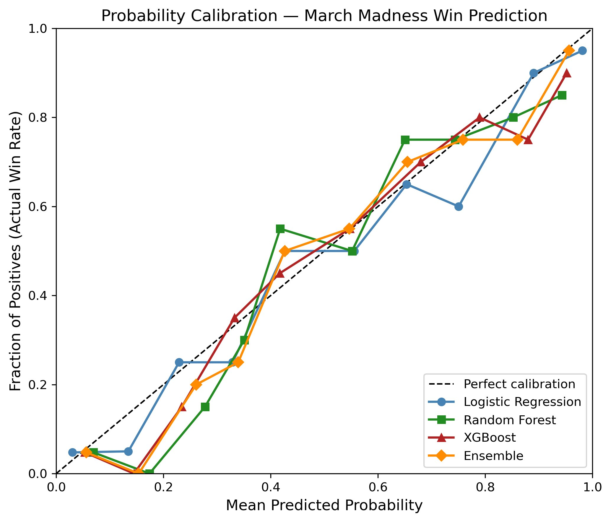
Results: Probability Calibration
All models track the diagonal reasonably well
XGBoost and Ensemble are best calibrated in the 0.4-0.7 range
Logistic Regression wanders between 0.6 and 0.85
Well-calibrated probabilities matter for bracket optimization
Figure 1: Probability calibration for all four models on the 2023-2025 test set.
8
Notes:
This is a calibration plot — predicted probability on the x-axis, actual win rate on the y-axis. A perfectly calibrated model follows the diagonal. When it says 70% chance, the team wins about 70% of the time.
All four models track the diagonal pretty well. XGBoost and the ensemble are tightest in the 0.4 to 0.7 range, which is where most of the action is. Logistic regression wanders a bit between 0.6 and 0.85.
The ensemble has the best log-loss even though its accuracy is a hair lower than XGBoost. Averaging probabilities from three different model families smooths out the individual quirks. For bracket optimization, calibrated probabilities matter more than a one-point accuracy edge.

Slide 10
Results: Round-by-Round Accuracy
Round | LR | RF | XGB | Ens. | N
Play-In | 75.0% | 58.3% | 75.0% | 58.3% | 12
Rd. of 64 | 77.1% | 81.3% | 79.2% | 77.1% | 96
Rd. of 32 | 79.2% | 81.3% | 83.3% | 85.4% | 48
Sweet 16 | 58.3% | 62.5% | 62.5% | 62.5% | 24
Elite 8 | 83.3% | 66.7% | 75.0% | 75.0% | 12
Final 4 | 83.3% | 83.3% | 83.3% | 83.3% | 6
Champ. | 66.7% | 66.7% | 66.7% | 66.7% | 3
All models drop to 58-63% in the Sweet 16. By that round, remaining teams are all strong and efficiency gaps compress. Late-round sample sizes (3-6 games) are too small to draw conclusions.
9
Notes:
Breaking it down by round is where it gets interesting. Early rounds go well — 77 to 85% in the Round of 64 and Round of 32. That makes sense because the efficiency gaps are biggest there.
The Sweet 16 is where everything falls apart. All models drop to 58 to 63%. By that point every remaining team is good. A matchup between a 1-seed and a 4-seed might have a 5-point efficiency gap, and that is well within the noise of a single basketball game.
Final Four and Championship numbers look high at 83% but those come from 6 and 3 games. Not enough to mean much.

Slide 11
Results: Season & Feature Analysis
Season-by-Season Accuracy
Feature Importance (Ranked)
Year | LR | XGB | Ens
2023 | 68.7% | 70.1% | 70.1%
2024 | 73.1% | 79.1% | 74.6%
2025 | 85.1% | 83.6% | 83.6%
# | Feature | Avg Imp.
1 | delta_adjoe | 0.278
2 | delta_adjde | 0.256
3 | delta_sos | 0.189
4 | seed_gap | 0.170
5 | delta_win_pct | 0.059
6 | round | 0.048
Efficiency metrics (adjoe, adjde) dominate, accounting for 50%+ of importance. Last-10-games win percentage and round barely matter. Season-long quality metrics do the heavy lifting; recent momentum adds almost nothing.
10
Notes:
Season by season, there is a lot of variance. 2023 was rough for every model at around 69 to 70%. 2025 was easy at 84 to 85%. Some years just have more upsets. Three tournaments is honestly not a lot to draw conclusions from.
On feature importance, adjusted offensive and defensive efficiency dominate. Together they account for over 50% of importance in both tree-based models. Strength of schedule and seed gap contribute some. Last-10-games win percentage and round barely register.
Season-long quality metrics are doing the heavy lifting. Recent momentum adds almost nothing.

Slide 12
Discussion & Conclusions
Model complexity does not help — LR is nearly as good as XGBoost (all p > 0.50)
Efficiency metrics are the strongest predictors of tournament outcomes
Sweet 16 is where all models struggle — matchups get too close
Ensemble has best-calibrated probabilities despite not having highest accuracy
Limitations
Small test set (201 games) — accuracy gaps fall within statistical noise
Only 6 features — no player-level, tempo, or injury data
Year-to-year variance means results may not generalize
Future: add tempo, player stats, injuries; simulate full brackets; extend to women's tournament
11
Notes:
So the main finding — model complexity does not help. Logistic regression is statistically indistinguishable from XGBoost. The decision boundary is roughly linear.
The Sweet 16 accuracy drop is probably the most interesting result. It connects directly back to the upset problem I started with.
The ensemble is worth noting because it has the best calibration despite not having the highest accuracy. For bracket filling, where probability quality matters, that is the one I would actually use.
On limitations — 201 games is a small test set. Only 6 features with no player data. Year-to-year variance is high. If I continued this, I would add tempo, player-level stats, and injuries. I would also try simulating full brackets against public pools.

Slide 13
Reflection: Most Technically Challenging?
Data merging between BartTorvik and Kaggle. 15 teams did not match and had to be corrected by hand due to naming differences.
Getting the difference vector logic right — reversing defensive efficiency so positive always means an advantage took more thought than expected.
12
Notes:
The hardest part was the data merge. Fifteen teams did not match between BartTorvik and Kaggle. Things like one source using 'St.' and the other using 'State.' Had to go through them one by one.
Getting the difference vector logic right also took more thought than I expected. Reversing defensive efficiency so positive always means an advantage sounds simple, but it is easy to get wrong and hard to catch if you do.

Slide 14
Reflection: Learned the Most About?
Feature engineering. There are a lot of ways to represent the same data, and small decisions like whether to encode matchups as raw features or differences change everything downstream.
I gained an appreciation for how hard it is to build a model that meaningfully beats a simple baseline. That turned out to be one of the main findings.
13
Notes:
Feature engineering. There are a lot of ways to represent the same data, and small decisions like encoding matchups as raw features versus differences change everything that comes after.
I also learned how hard it is to beat a simple baseline. I went in expecting XGBoost to clearly win, and it turns out logistic regression does just as well. That ended up being one of the main findings of the whole project.

Slide 15
Reflection: Top Priority for Future Work?
Add player-level data and injury information instead of relying only on team-level stats.
Try tempo/pace of play as a feature since pace mismatches can swing games.
Use a larger test set to get more statistical power out of model comparisons.
14
Notes:
Top priority would be player-level data and injury information. Right now everything is team-level aggregates, and that is probably why the models plateau around 75%.
I would also add tempo as a feature. Pace mismatches can swing games in ways that efficiency metrics alone do not capture.
And I would use a larger test set. Three tournaments is not enough to make strong claims about which model is better.

Slide 16
Questions?

